Slide 1


Unit 1: Lesson 1 Your world

Slide 2
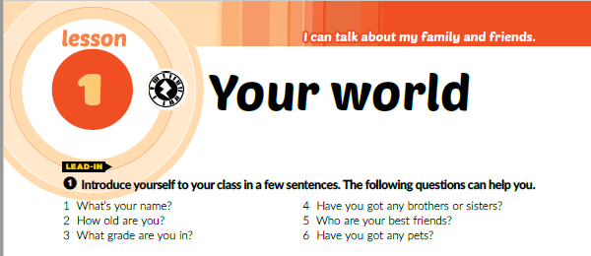
Textbook p. 12
Task ❶ Introduce yourself to your class in a few sentences.
The following questions can help you.

Slide 3
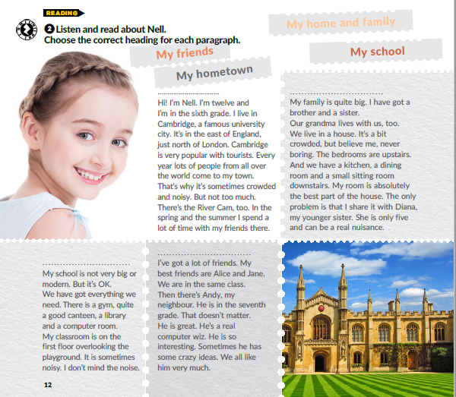
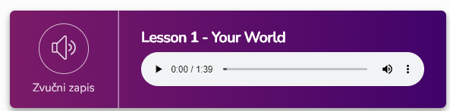
Task ❷ Listen and read about Nell. Choose the correct heading for each paragraph.
My hometown
My family
https://www.e-sfera.hr/dodatni-digitalni-sadrzaji/a0ee66c7-5d0a-46f4-ad41-8f8a5d305adb/
My school
My friends

Slide 4
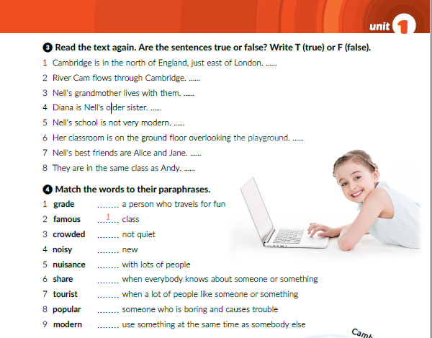
Task ❸ Read the text again. Are the sentences true or false?
Write T (true) or F (false).
F
T
T
F
T
F
T
F
Task ❹ Match the words to their paraphrases.
7
4
9
3
2
8
5
6

Slide 5
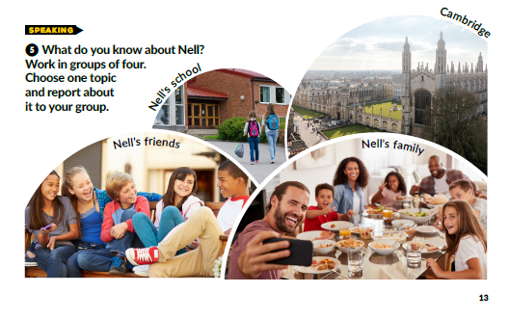
Task ❺: What do you know about Nell? Work in groups of four. Choose one topic and report about it to your group.

Slide 6
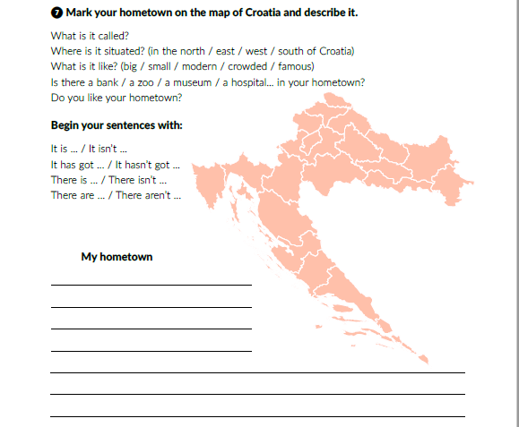
Workbook p. 8
Task ❼: Mark your hometown on the map of Croatia and describe it.

Slide 7
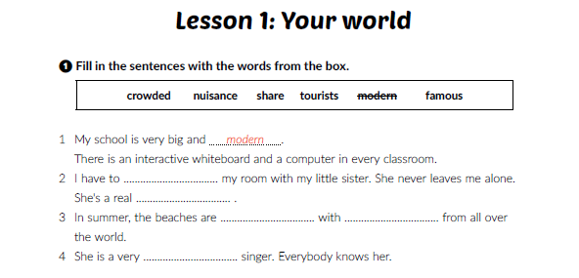
Workbook p. 6
Task ❶ Fill in the sentences with the words from the box.
share
nuisance
crowded
tourists
famous

Slide 8
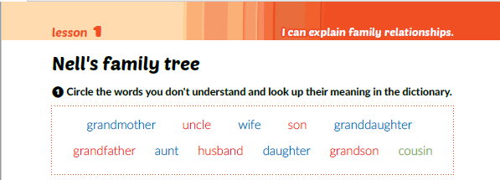
Textbook p. 14
Task ❶: Circle the words you don't understand and look up their meaning in the dictionary.
Why are some words written in blue and some in red? Why is the word cousin written in green?

Slide 9
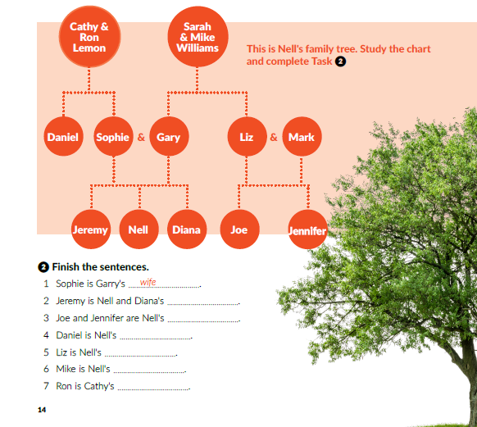

This is Nell's family tree. Study the chart and complete Task ❷
brother
cousin
father
son
aunt
daughter
grandfather
wife
husband

Slide 10
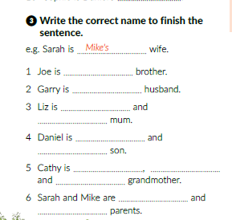
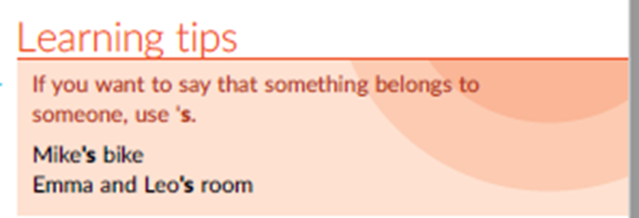
Jennifer’s
Liz’s
Joe
Jennifer’s
Cathy
Ron’s
Jeremy
Nell
Diana’s
Gary
Liz’s

Slide 11
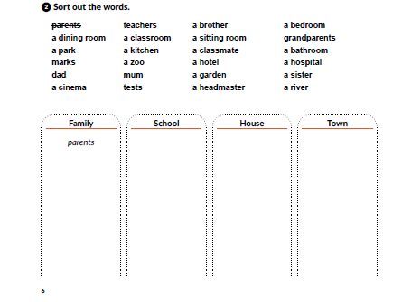
Workbook p 6. Task ❷: Sort out the words.
marks
teachers
a classroom
tests
a classmate
a headmaster
a dining room
a kitchen
a sitting room
a garden
a bedroom
a bathroom
a park
a cinema
a zoo
a hotel
a hospital
a river
dad
a brother
mum
a brother
grandparents
a sister

Slide 12
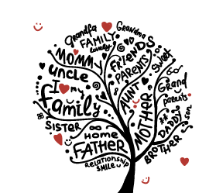
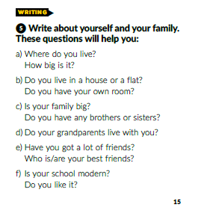

Textbook p. 15

Slide 13
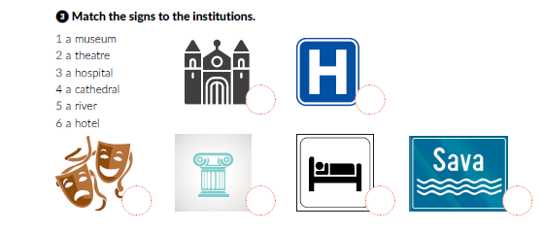
Workbook p. 7 Match the signs to the institutions.
4
3
2
1
3
5

Slide 14
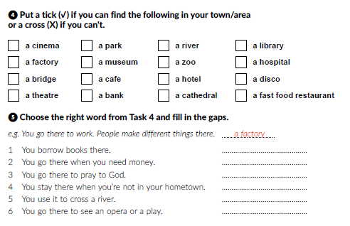
Workbook p. 7.
a library
a bank
a cathedral
a hotel
a bridge
a theatre

Slide 15

Family tree - Teaching resource (wordwall.net)

